Slide 1
Set Below profile before OA FRAME WORK Personalization
1. Set FND: Personalization Region Link Enabled (FND_PERSONALIZATION_REGION_LINK_ENABLED) to Yes
Now Personalize Region links should appear above each region in a page. Each link takes the user first to the Choose Personalization Context page, then to the Page Hierarchy Personalization page with focus on the region from which you selected the Personalize Region link.
2. Personalize Self-service Defn (FND_CUSTOM_OA_DEFINTION)
You should set this profile option to Yes at the user level for an administrator. If you set this profile option to Yes, then when you log on as the Administrator, a global Personalize Page button appears on each OA Framework-based application page. When you select the global Personalize Page button on any page, the personalization user interface prompts you for the scope and administrative level at which you wish to create your personalizations before displaying the OA Personalization Framework UI.

Slide 2
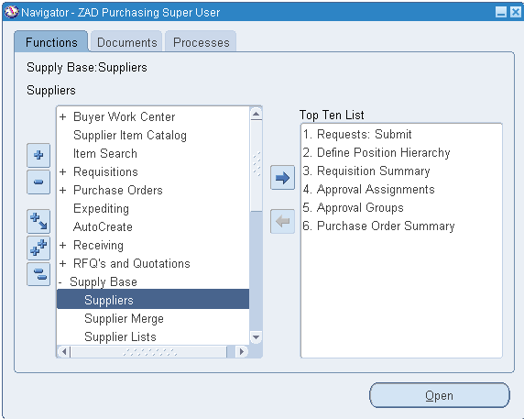
Navigation: Purchasing Super User Responsibility
Supply Base→ Suppliers

Slide 3
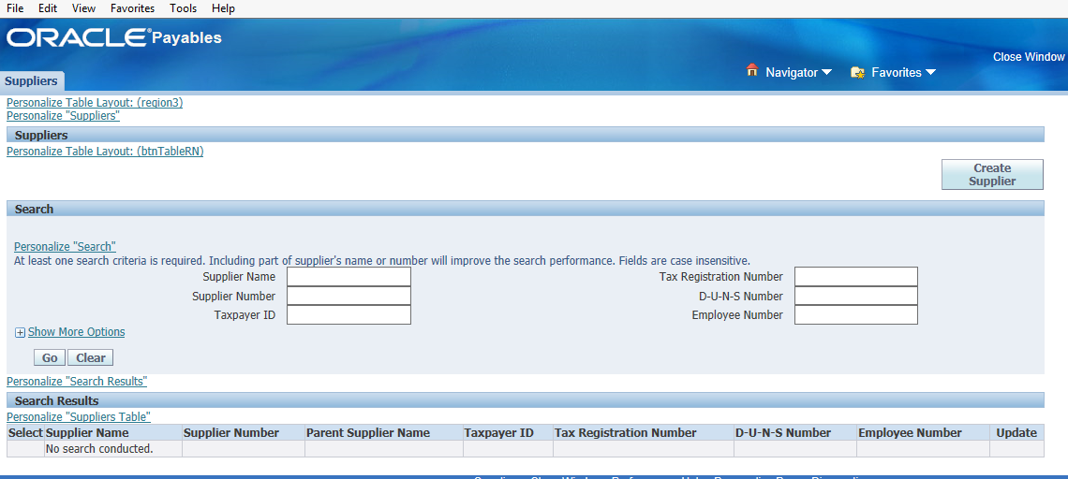
Click Here

Slide 4
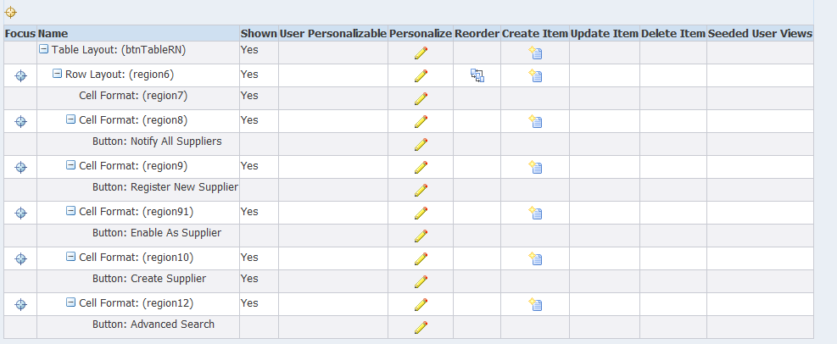
Click Here

Slide 5
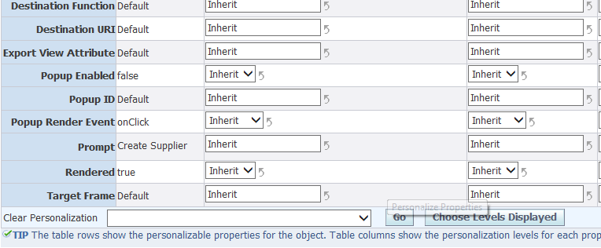
Below screen will open
This is default value change it to False

Slide 6
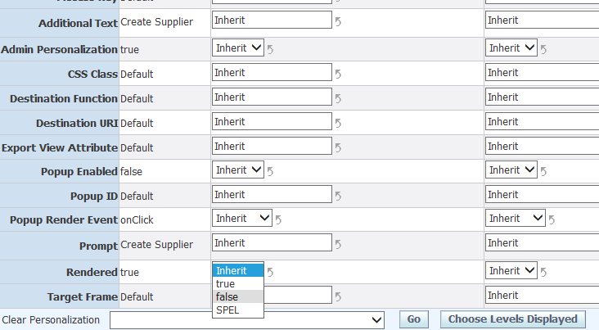
Change value from Inherit to False

Slide 7
This is default value change it to False
Press APPLY

